Slide 1

(Very Brief) Introduction to Bayesian Statistics
Stat 5444
Aug. 21, 2018
Scotland Leman
You may call me: Scotland, Mr. Leman, Dr. Leman, Dr. Scotland, Dr. Mr. Scotland, Whatever! Just be polite, please ☺

Slide 2

Outline
Bayes’ theorem
Bayesian statistics: Some History
The Likelihood function and the Prior/Posterior distributions
Monte Carlo: Random Answer in a Finite amount of Time.
Independent Case
Some necessary Markovian theory (I cover the majority of this in STAT 5314)
Markov Chain Monte Carlo

Slide 3
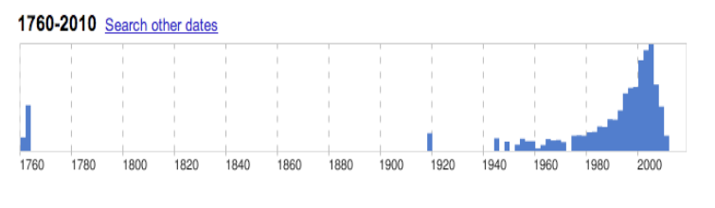
Visual Analysts
What’s a Bayesian?
The word Bayesian has been used for a long time.

Slide 4
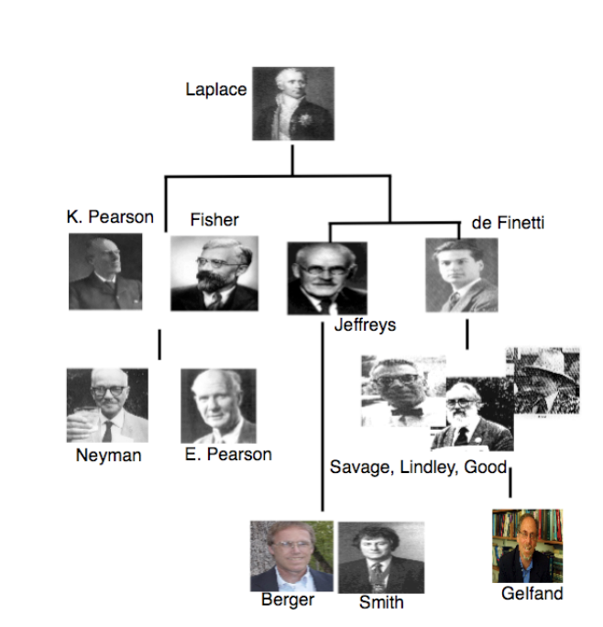
Visual Analysts
What’s a Bayesian?
An Evolution of Bayesian Thought:
Laplace understands the implications
behind what Bayes knew.
Statistics is born, and Bayesian ideas
were discussed, but not recognized.
Bayesian methods are argued for on
philosophical grounds, but not yet
widely practiced.
MCMC is born, and Bayesian methods
become common place.

Slide 5
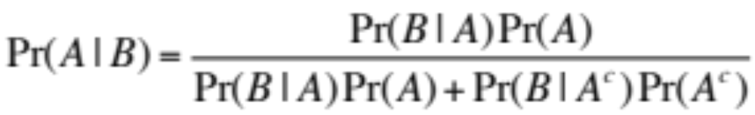
Visual Analysts
What’s a Bayesian?
The history of Bayesian statistics began in 1763 with a paper by Thomas Bayes,
in which he outlined a formula that has come to be called Bayes’ Rule (or Bayes Rule):
Note: this is a true probability statement, and it is completely uncontroversial.

Slide 6
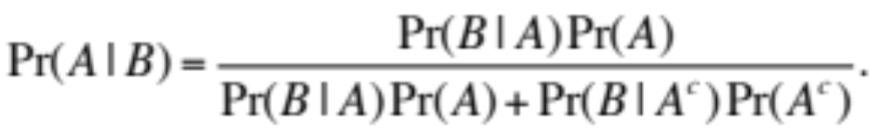
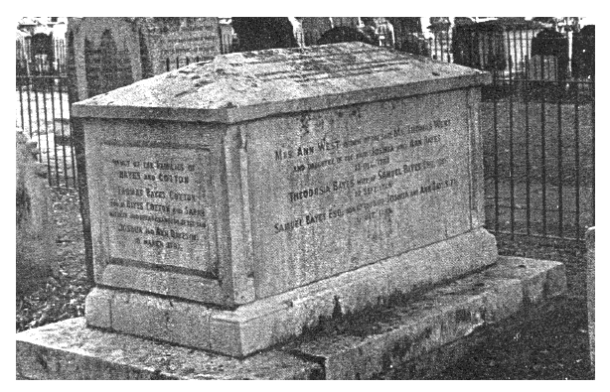
Visual Analysts
What’s a Bayesian?
The history of Bayesian statistics began in 1763 with a paper by Thomas Bayes,
in which he outlined a formula that has come to be called Bayes’ Rule (or Bayes Rule):
The Beginning:
Bayes did not actually publish his paper before death.

Slide 7
Visual Analysts
What’s a Bayesian?
The publication in question: Essay by Richard Price to John Canton, FRS:
Dear Sir,
Read Dec. 23, 1763. I now send you an essay which I have found among the papers
of our deceased friend Mr. Bayes, and which, in my opinion, has great merit, and
well deserves to be preserved. Experimental philosophy, you will find, is nearly
interested in the subject of it; and on this account there seems to be particular reason
for thinking that a communication of it to the Royal Society cannot be improper.
…
That your enquiries may be rewarded with many further successes, and that you
may enjoy every valuable blessing, is the sincere wish of, Sir, your very humble
servant,
Richard Price.

Slide 8
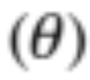
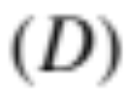
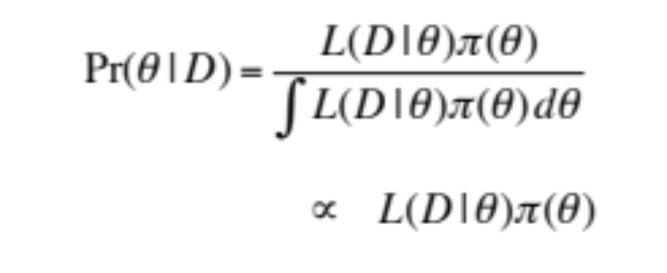
Visual Analysts
What’s a Bayesian?
From Bayes to Bayesian (Bayesien):
Oddly enough, Bayes was not really a Bayesian. Recall Bayes’ Rule:
A Bayesian operates through this rule, but the sets are defined by:
A = Parameter Space , and
B = Data . So we have:
Posterior
Likelihood function Prior

Slide 9
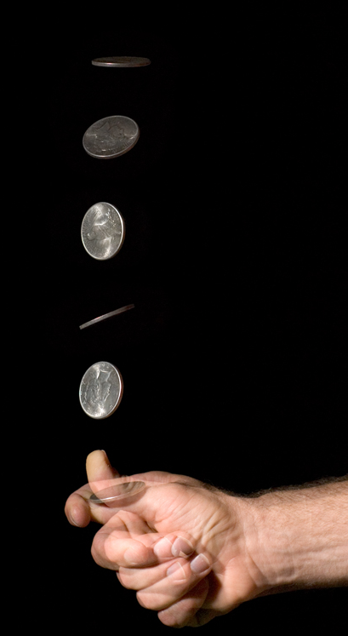
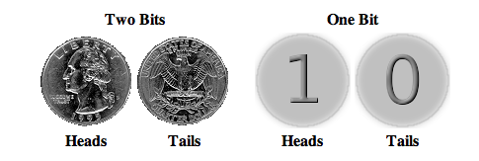
Visual Analysts
What’s a Bayesian?
Consider the following experiment:
Flip a coin, with a fixed probability (p) of producing
a `Heads’ or `Tails’.
Question: How much information is contained in
12.5 cents?
This simple example is more than enough to understand
differences between Bayesians and Classicists.

Slide 10

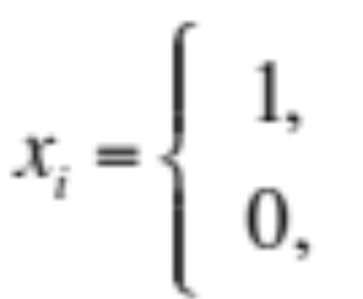
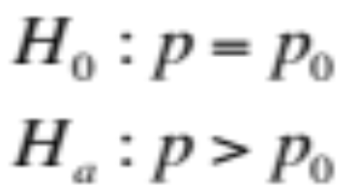
Visual Analysts
What’s a Bayesian?
The basic question of interest is:
given a few flips of the coin ,
what’s the “success” probability (p) of the coin?
with probability p
with probability 1-p
In Classical statistics, typically one writes down:
and prompts you for a p-value
(probability of more extreme data than you
observed, conditional on the null hypothesis).

Slide 11
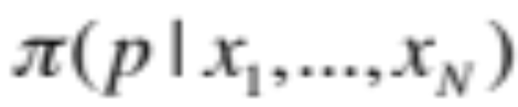
Visual Analysts
What’s a Bayesian?
The basic question of interest is:
given a few flips of the coin ,
what’s the “success” probability (p) of the coin?
with probability p
with probability 1-p
In Bayesian statistics, one wishes to compute the posterior
distribution:
i.e. what’s the posterior distribution (or density)
for the parameter of interest (p),
given the data.

Slide 12
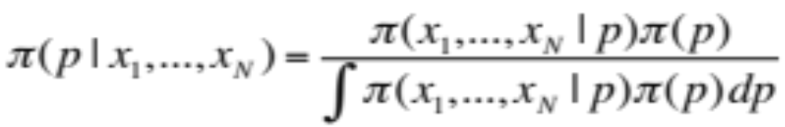
Visual Analysts
What’s a Bayesian?
The basic question of interest is:
given a few flips of the coin ,
what’s the “success” probability (p) of the coin?
with probability p
with probability 1-p
In Bayesian statistics, one wishes to compute the posterior
distribution:

Slide 13
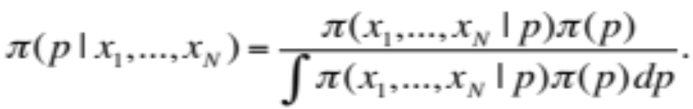
Visual Analysts
What’s a Bayesian?
In Bayesian statistics, one wishes to compute the posterior
distribution:
Likelihood function
(conditional on data)
Prior
Prior information: what can we possibly know about p?
Maybe you know something about my coin
Maybe you have no idea, and you need to be sensitive
about making arbitrary assumptions.
In either case, you just want to know p
as accurately as possible.

Slide 14
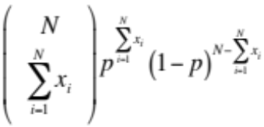

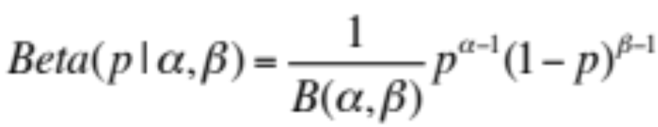
Visual Analysts
What’s a Bayesian?
In Bayesian statistics, one wishes to compute the posterior
distribution:
Where:
Question: can you work out the posterior distribution?

Slide 15
Visual Analysts
What’s a Bayesian?
Show experiment.

